Slide 1

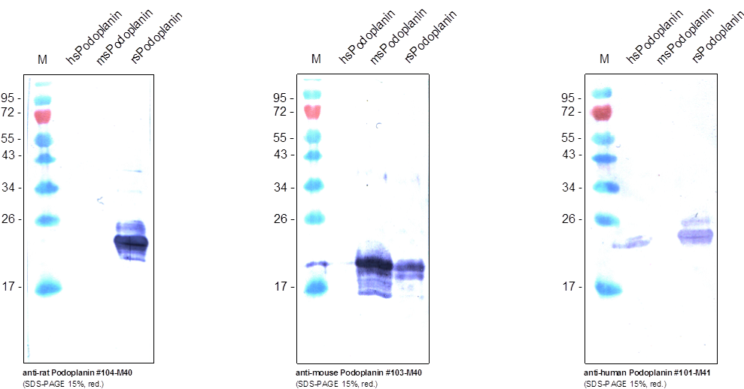
Reliatech GmbH
Human / Mouse / Rat Podoplanin
Western Analysis with monoclonal antibodies against rat (#104-M40), mouse (#103-M40) and human (#101-M41) soluble Podoplanin produced in E. coli. The anti-rat Podoplanin shows no cross reactivity with mouse and human whereas the anti-mouse Podoplanin cross reacts with recombinant rat soluble Podoplanin. The anti-human Podoplanin shows no cross reactivity with the mouse form but a strong one with the rat form. In this case the signal for the human sPodoplanin is weak.
http://www.reliatech.de / orders@reliatech.de

